Slide 1
CSC 3210 Computer Organization and Programming
Lab Work 5
Dr. Zulkar Nine
mnine@gsu.edu
Georgia State University
Spring 2021

Slide 2
Learning Objective
Listing File Format

Slide 3
Lab Work 5 Instructions
Lab 5 : Create a project and generate listing file (10 points)
Detailed instructions are in Slide 37 and 38
Due Date: 02/19/21 11:59 PM

Slide 4
Attendance!

Slide 5
How to create a Listing File
in Microsoft Visual Studio

Slide 6
Steps to follow
Step 1: Create a new project
Step 2: Configure settings for listing file
Step 3: Build project
Step 4: Open listing file

Slide 7
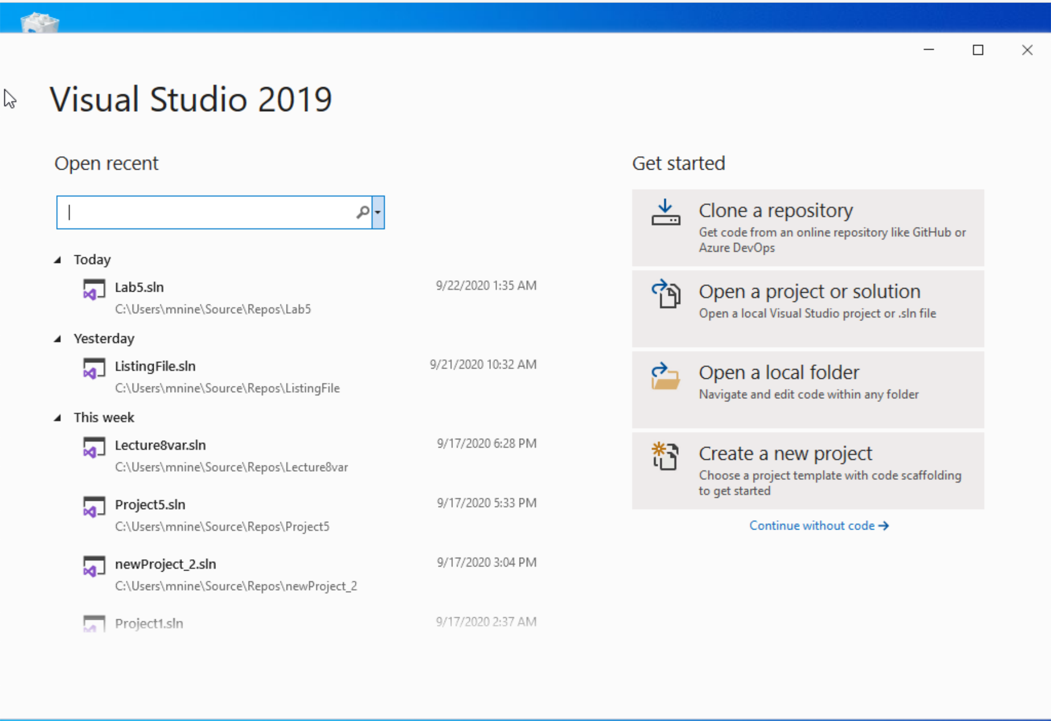


Step 1: Create a project (1)
Start Visual Studio
Click Create a new Project

Slide 8
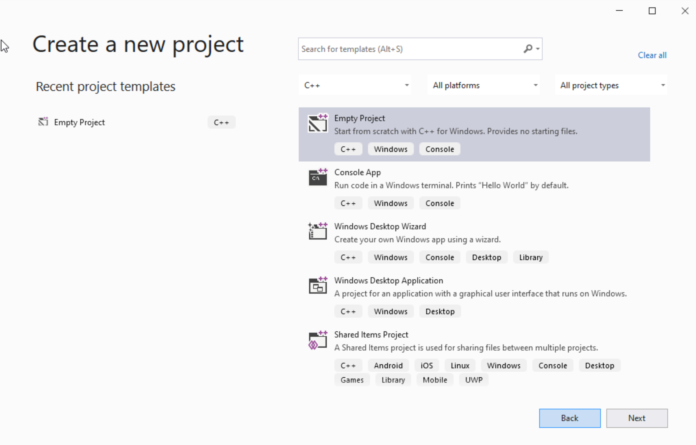




Step 1: Create a project (2)
Select C++ as language
Select Empty Project
Click Next

Slide 9
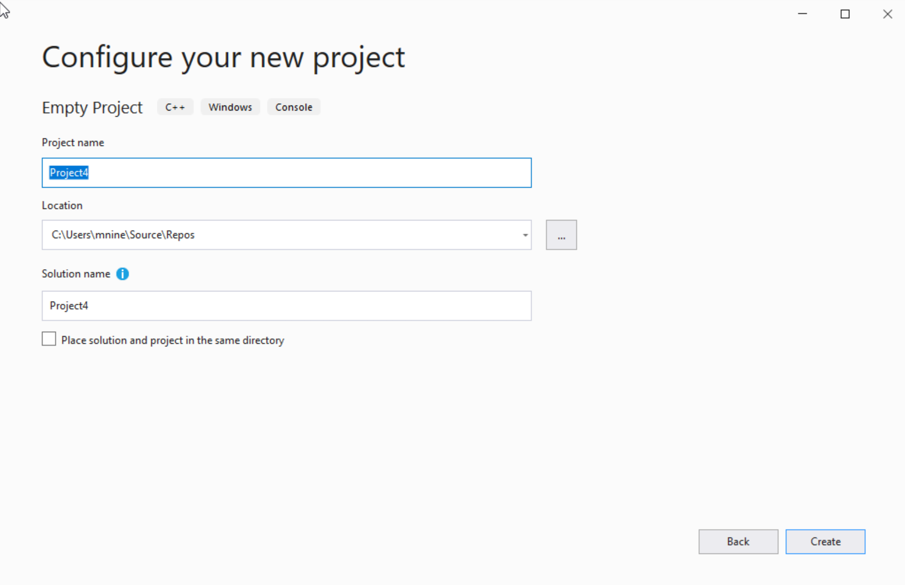

Step 1: Create a project (3)
You can change the project
name as you like
Also, you can change the
project location
Click Next

Slide 10
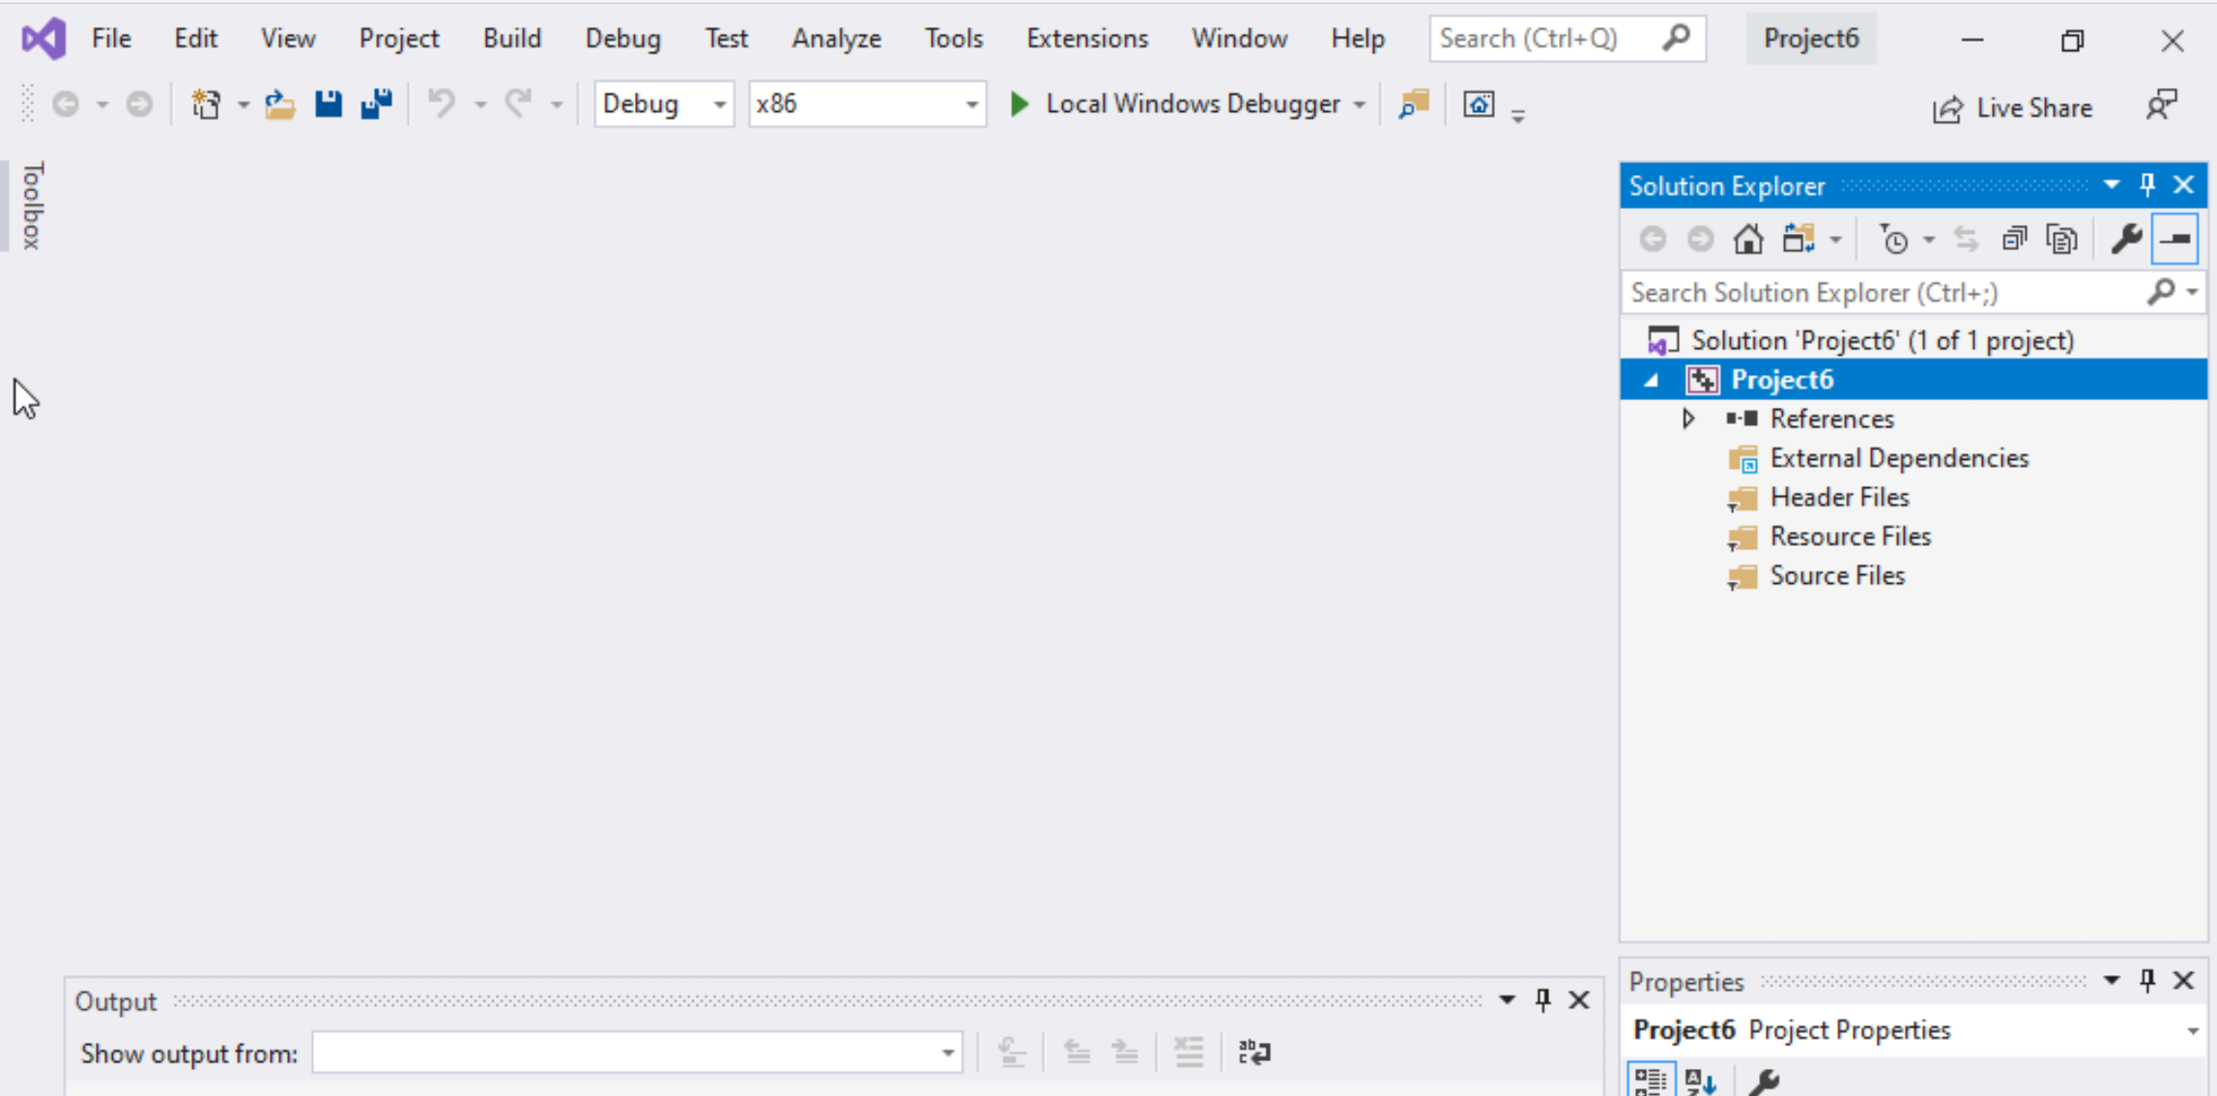
Step 1: Create a project (4)
Delete the
Following folders:
Header files
Resources Files, and
Source Files

Slide 11
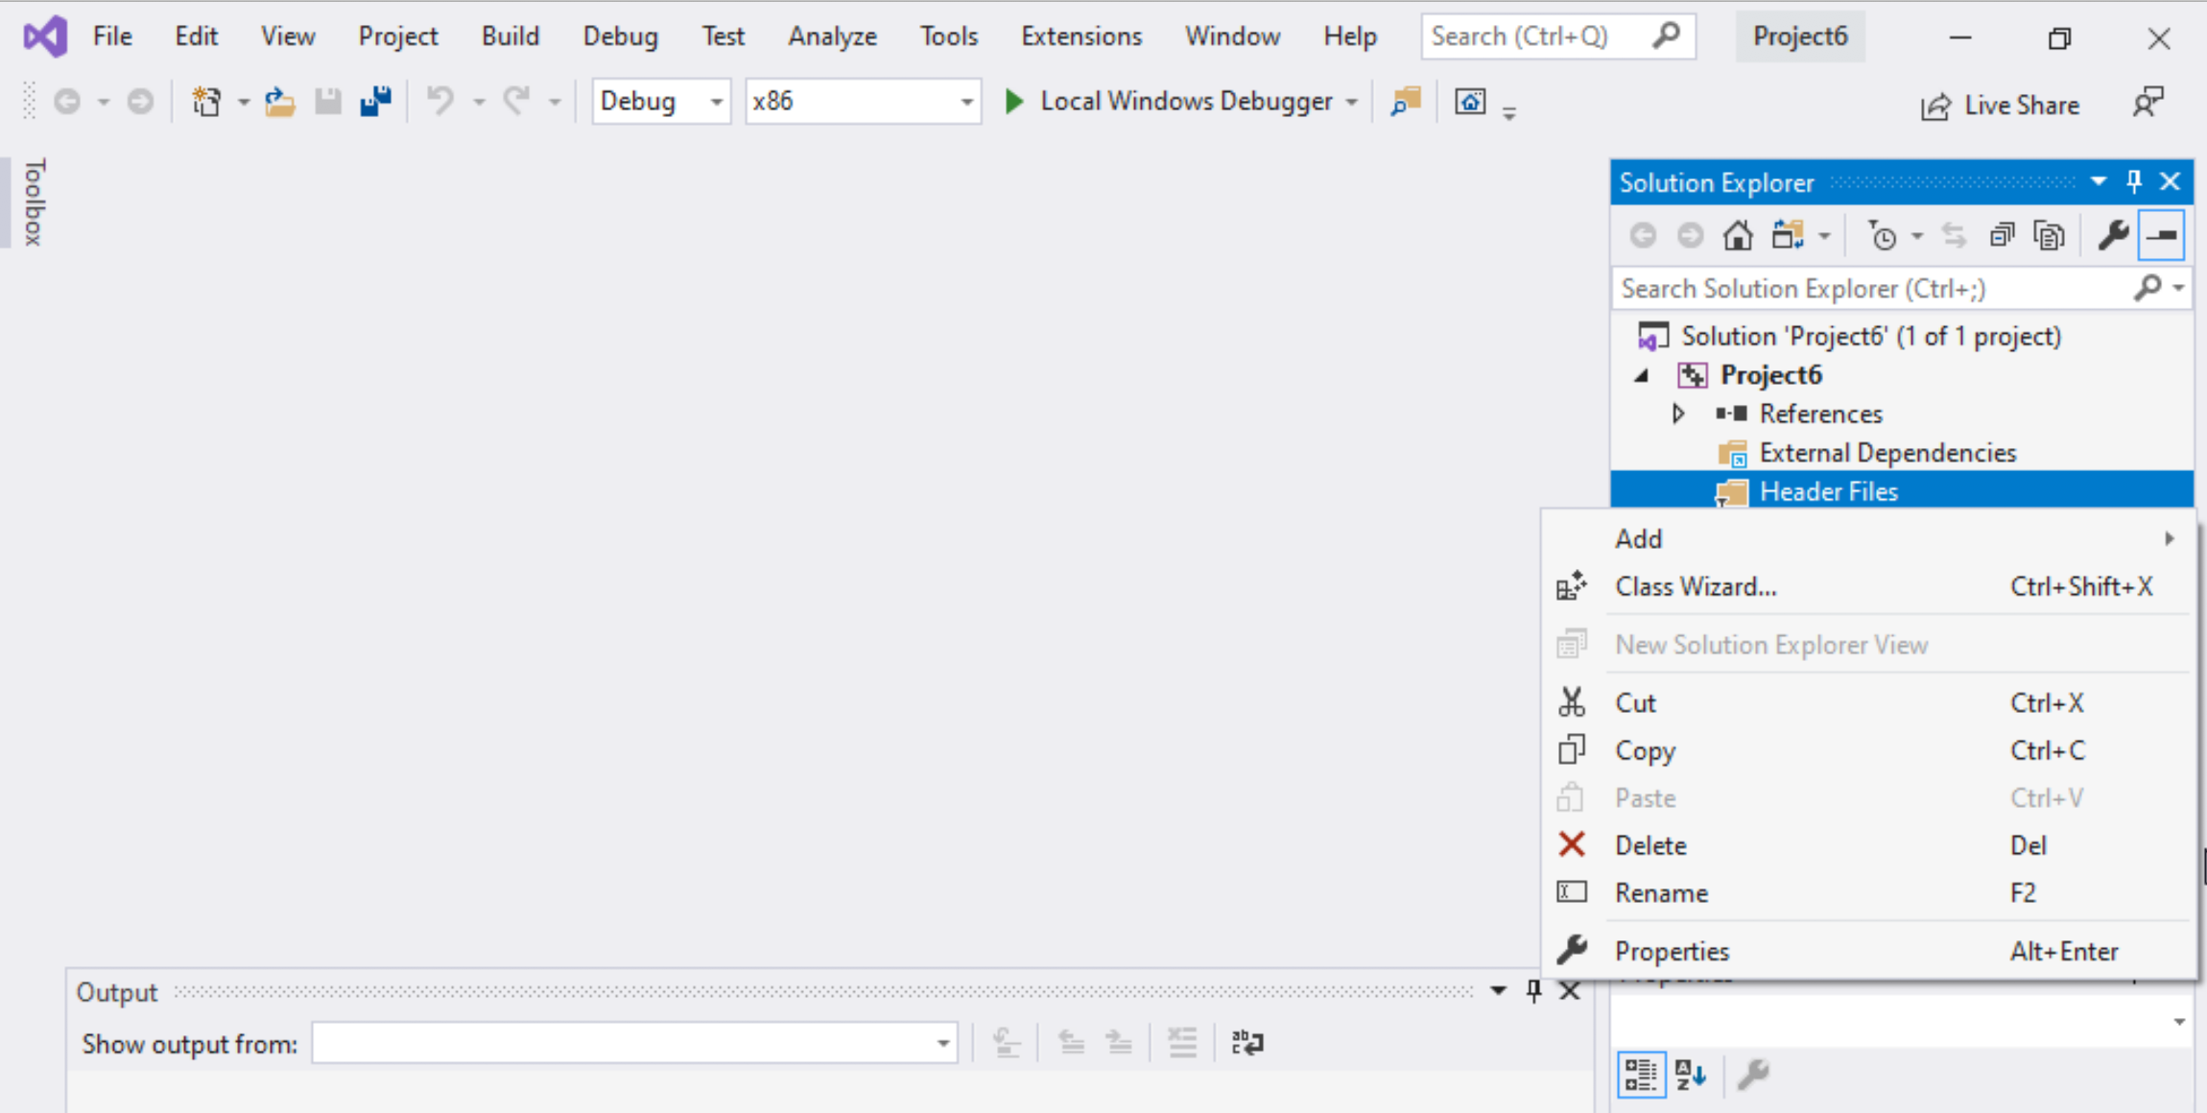
Step 1: Create a project (5)
To delete :
Select the folders
Right click on it
Select delete

Slide 12
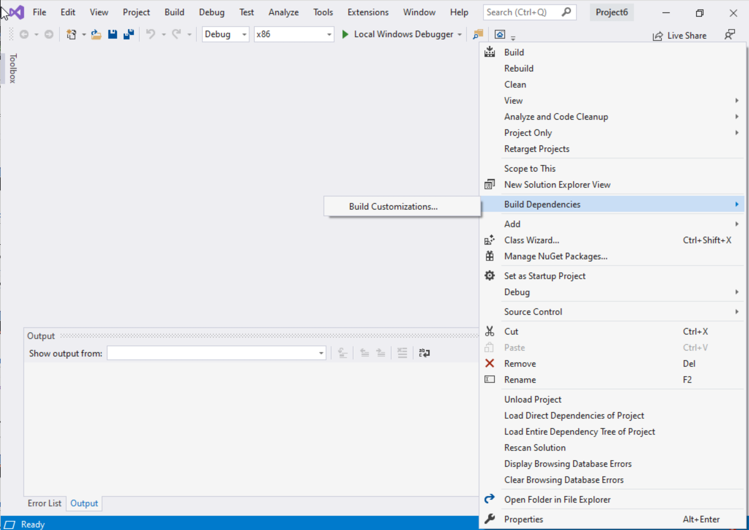
Step 1: Create a project (6)
Select Project Name on solution explorer
Right click on it
Go to Build Dependencies
Click on Build Customizations

Slide 13
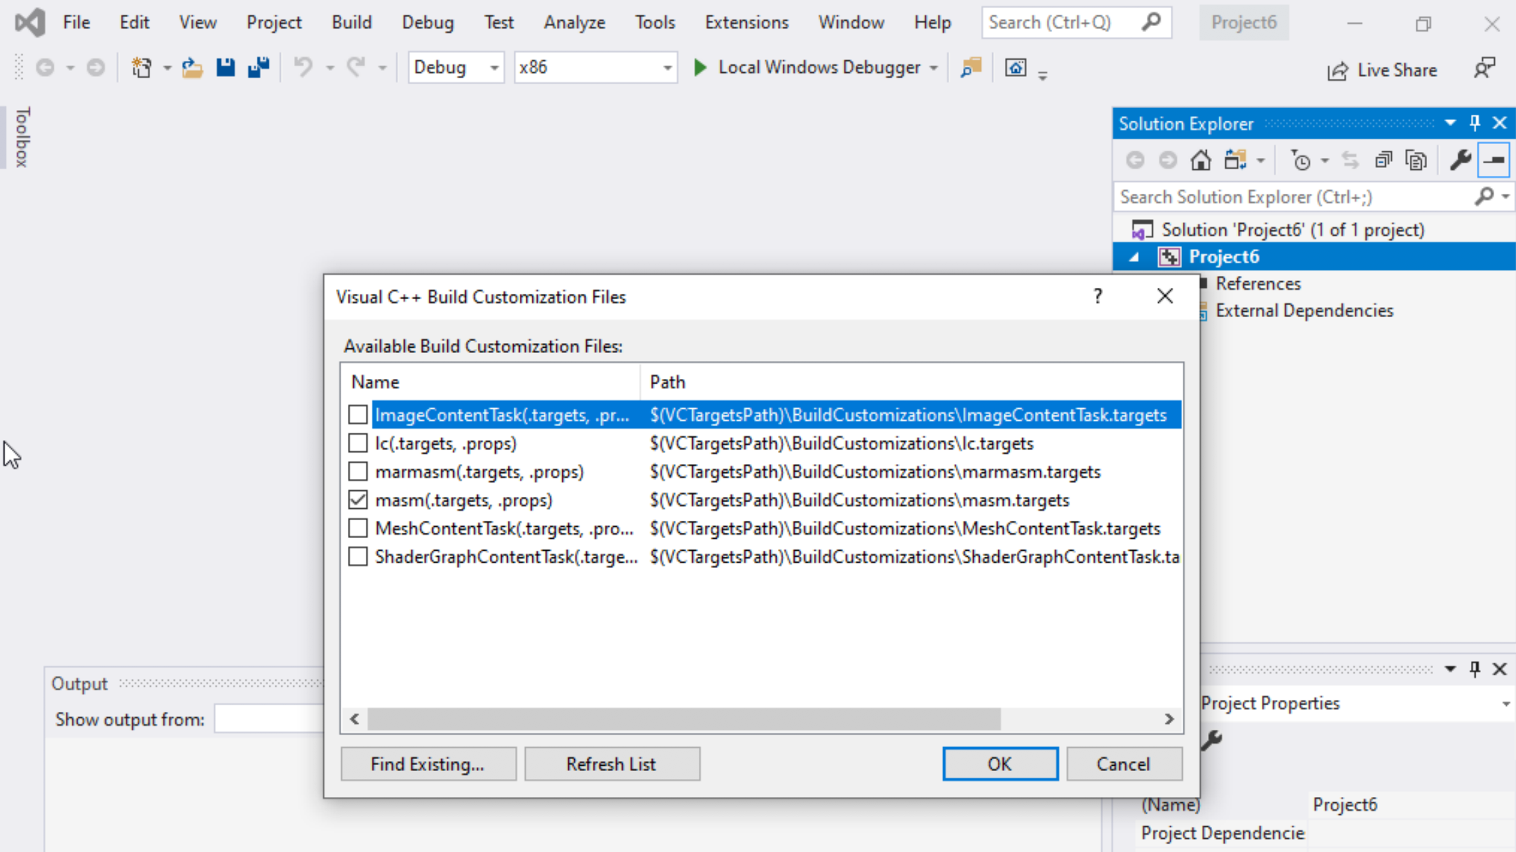
Step 1: Create a project (7)
Select masm(.target, .props)
Click ok

Slide 14
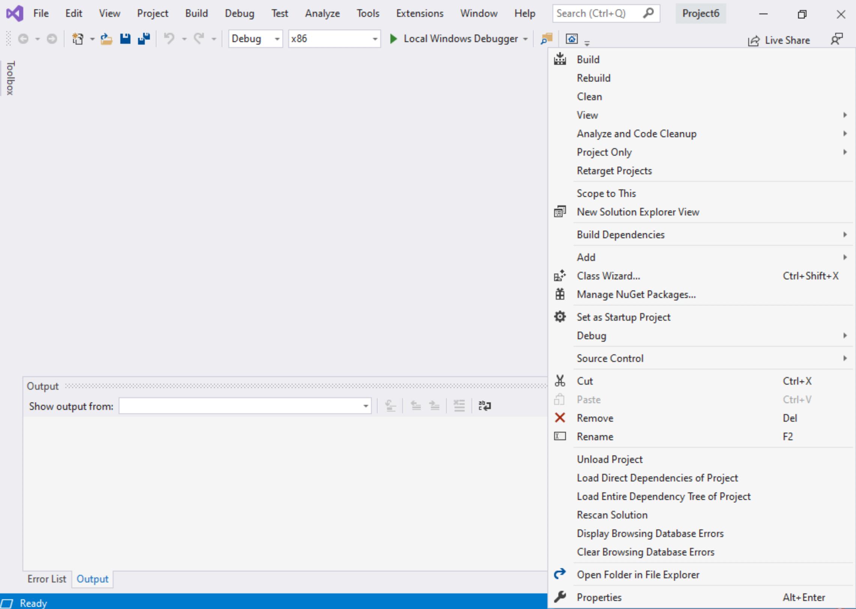
Step 1: Create a project (8)
Right click on the Project name in the solution explorer
Click properties

Slide 15
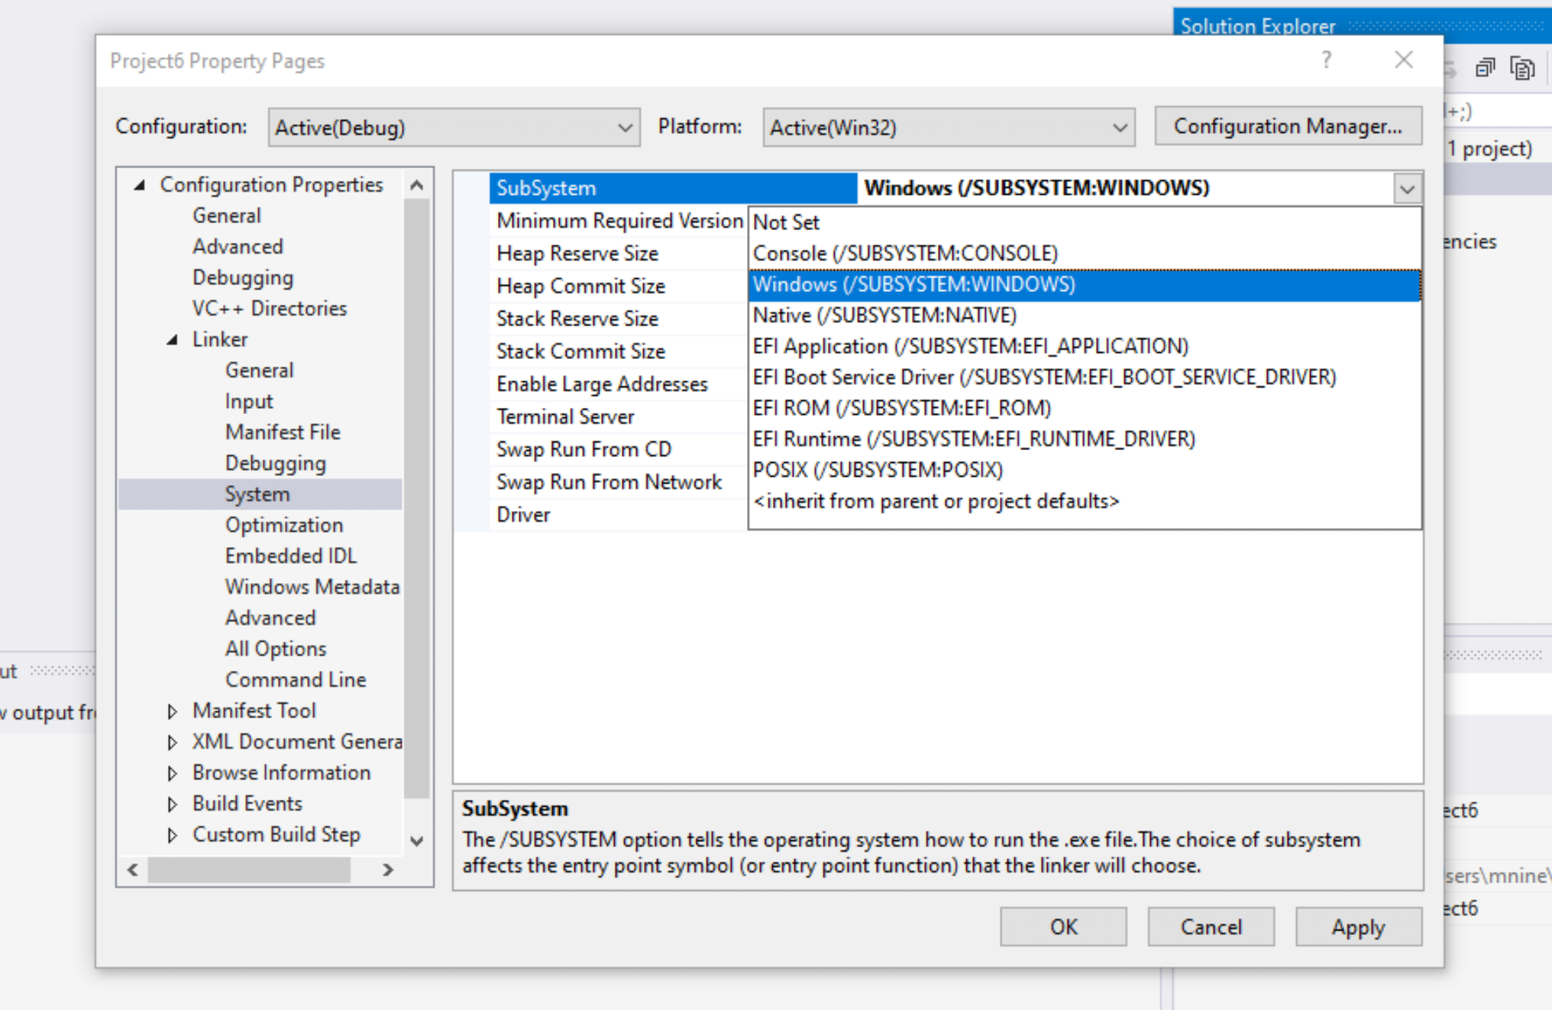

Step 1: Create a project (9)
Expand the ‘Linker’
Select ’System’
Select Windows(/SUBSYSTEM:WINDOWS)
Click OK

Slide 16
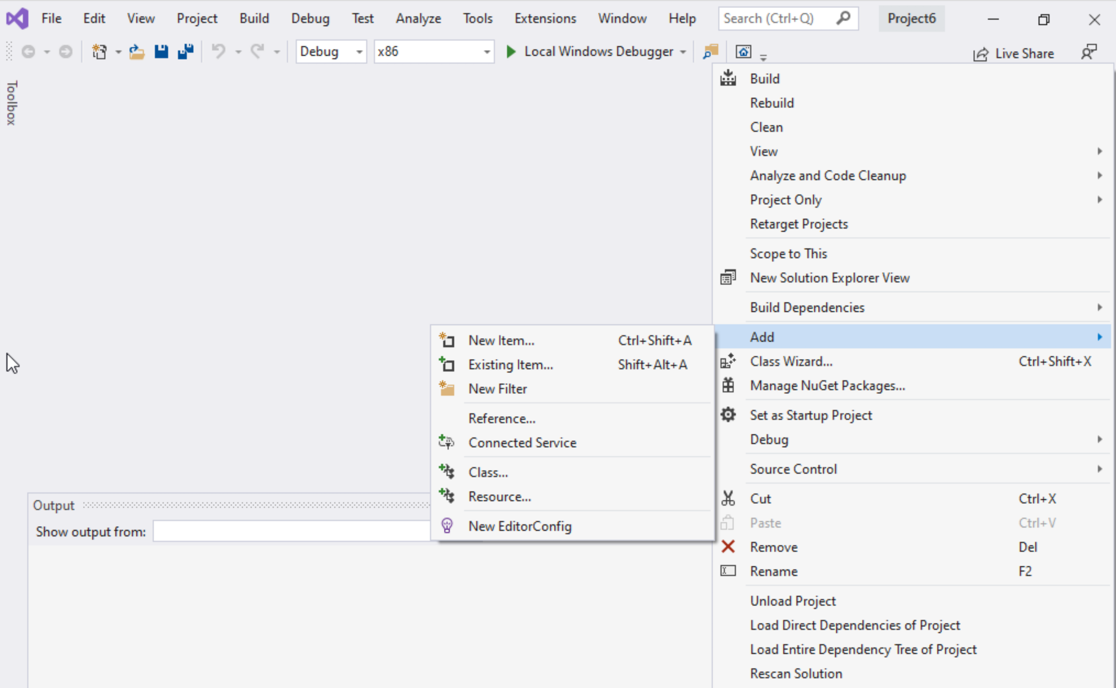
Step 1: Create a project (10)
Select Project name on solution explorer
Right click on it
Expand Add
Choose New Item

Slide 17
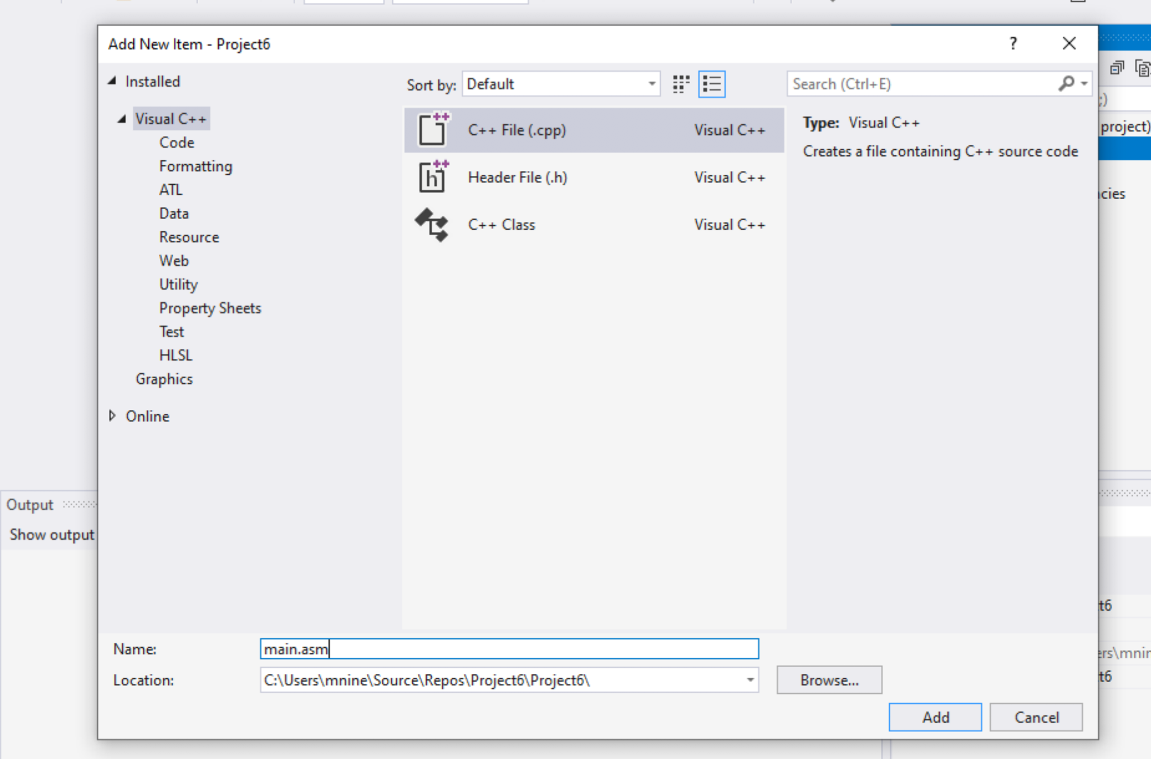


Step 1: Create a project (11)
Select C++ File(.cpp)
Name: main.asm
Click Add

Slide 18
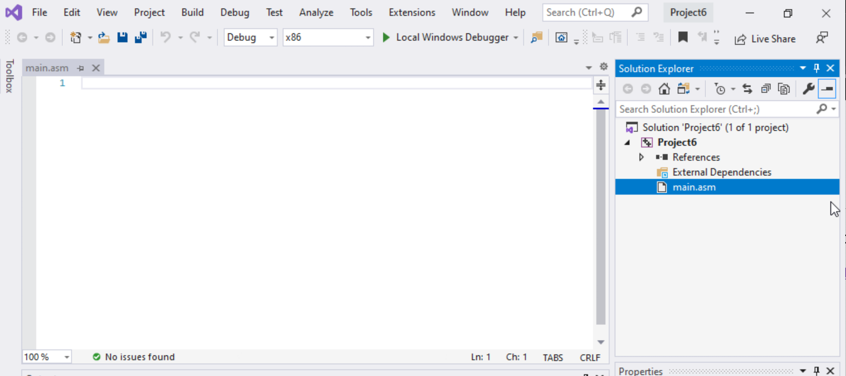

Step 1: Create a project (12)
Select main.asm
Add your code
In the main.asm File.

Slide 19
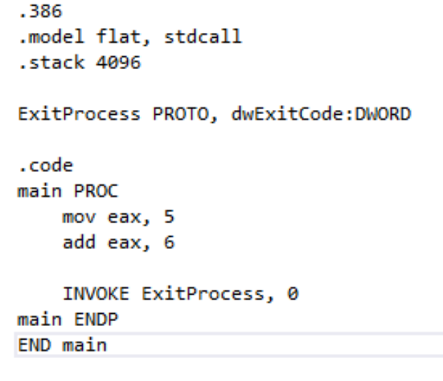
Sample Code
Type the sample code in the main.asm

Slide 20
Listing File
Contains
source code
addresses
object code (machine language)
segment names
symbols (names of : variables, procedures, and constants)
The format of the list file lines is
Notes:
June 16, Sum

Slide 21
Listing File
segment
addresses
source code
object code
Notes:
The symbol table contains the names of all program identifiers, segments, and
related information.

Slide 22
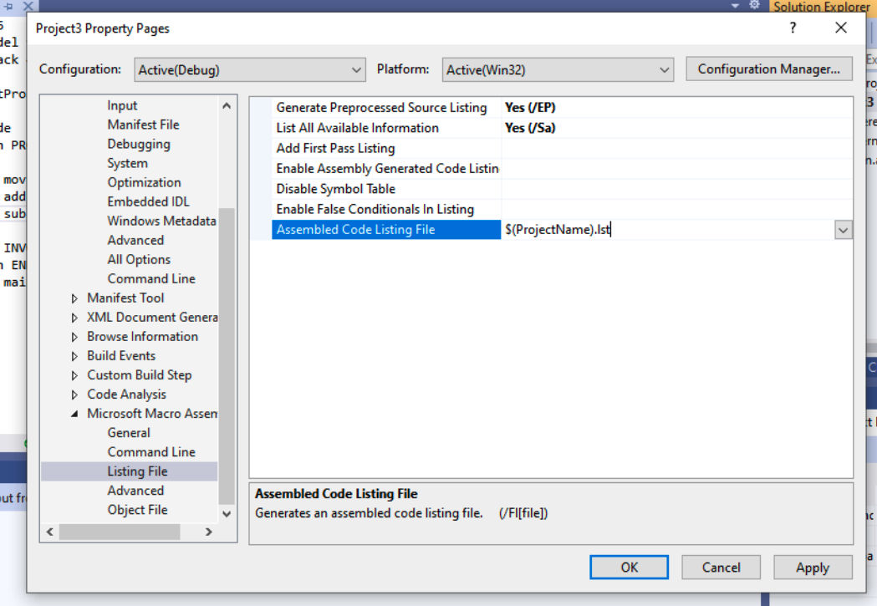
Listing File
Configuring Visual Studio to generate a listing file.
Select Properties from the Project menu.
Under Configuration Properties, select Microsoft Macro Assembler.
In the dialog window,
set Generate Preprocessed Source Listing to Yes,
set List All Available Information to Yes.
Write $(ProjectName).lst in
Assembled Code Listing File

Slide 23
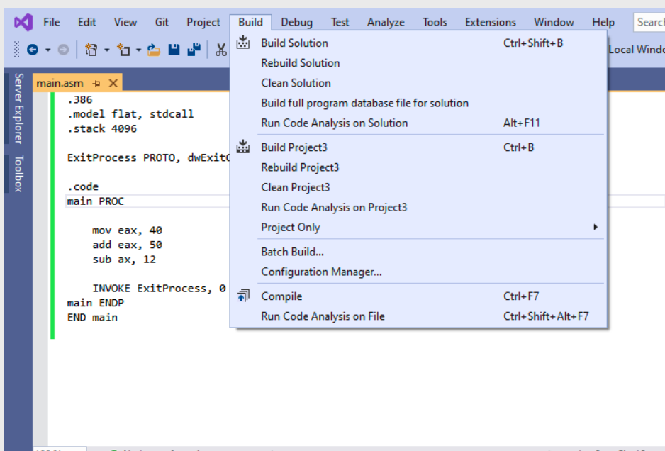


Step 3 : Build the Project
Go to Build tab
Click ‘Build Project’
It is always better to clean the project before building it
To clean the project
Go to build tab
Click ‘Clean project’

Slide 24
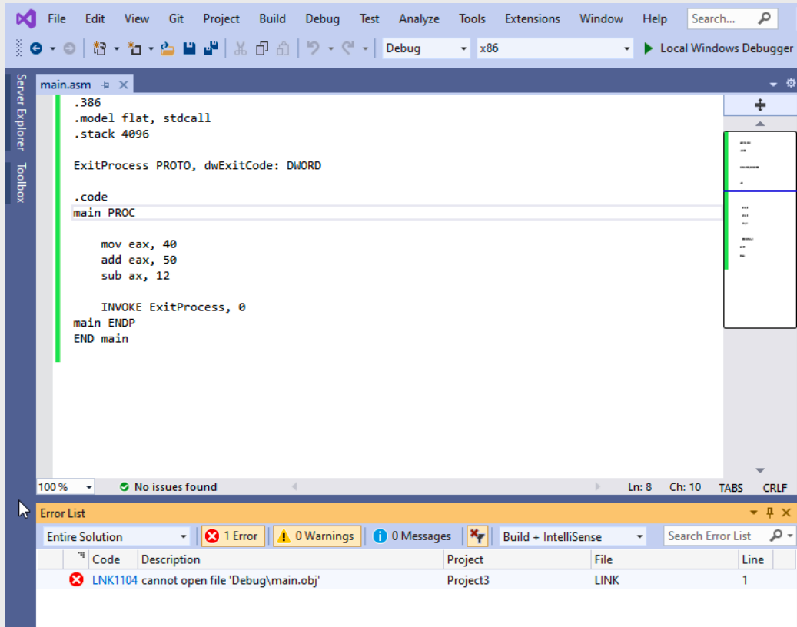


IF you see this error!
Error: LNK 1104: Cannot open file
‘Debug/main.obj’
Follow Steps from slide 25 to 32

Slide 25
IF you see this error!
Error: LNK 1104: Cannot open file
‘Debug/main.obj’
Solution:
Delete the listing file settings from configuration
Clean the project
Build the project again
Then re-enter the listing file settings
Clean the project
Build again

Slide 26
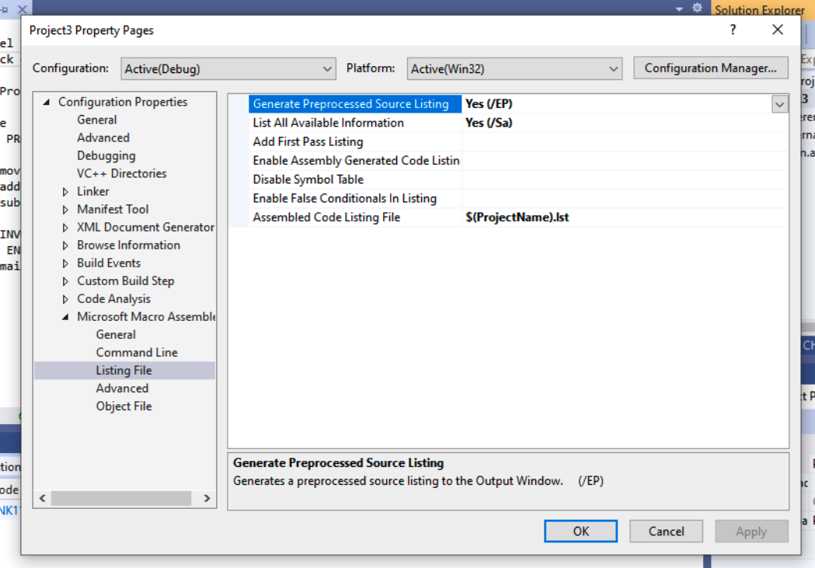
Error Fix: 1. Delete listing file configuration
Go to the Solution explorer
Right click on the Project name in the solution explorer
Click properties
Select Microsoft Macro Assembler
Then choose Listing File

Slide 27
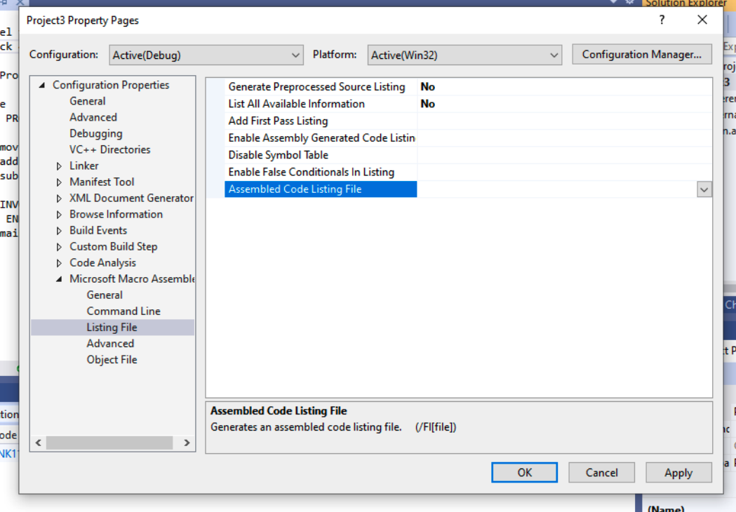


Error Fix: 1. Delete listing file configuration
Set Generate Preprocessed Source Listing to NO,
Set List All Available Information to NO.
Remove $(ProjectName).lst from
Assembled Code Listing File

Slide 28
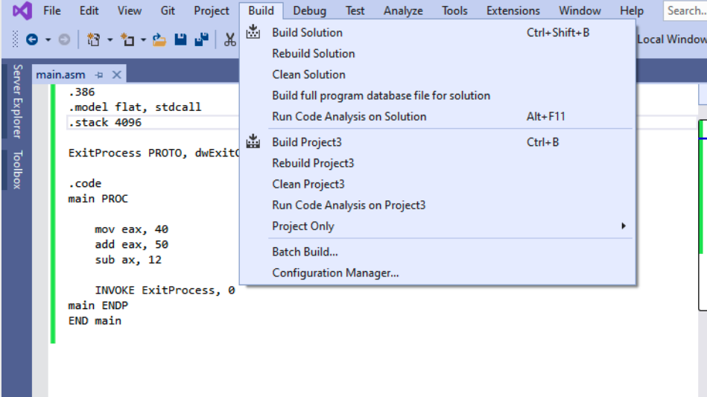


Error Fix: 2. Clean and Build the project (1)
Clean the project
Go to Build -> Clean Project
Build the project
Go to Build -> Build Project

Slide 29
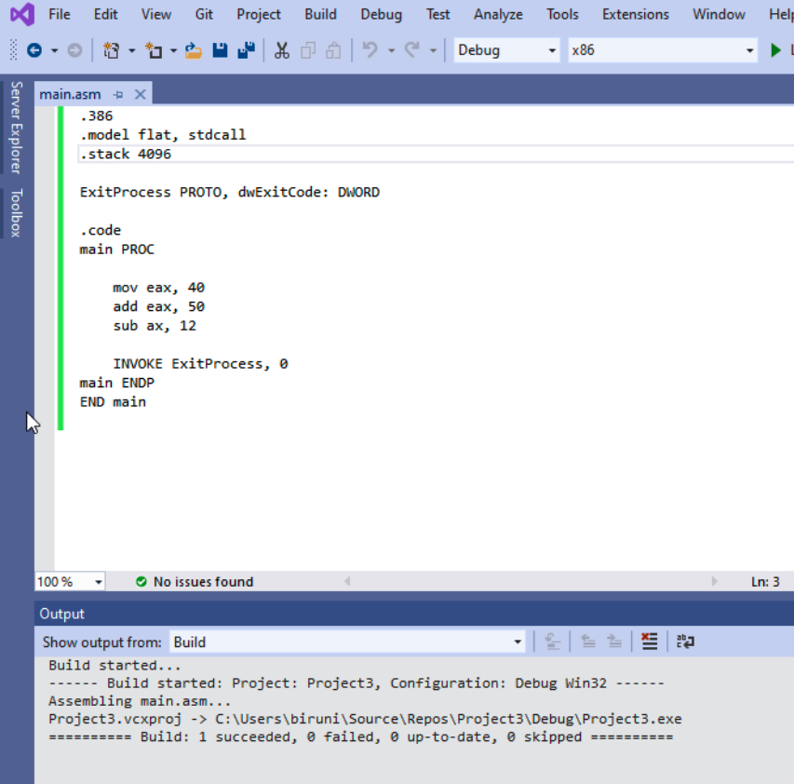


Error Fix: 2. Clean and Build the project (2)
You should see the message showing that build is successful

Slide 30
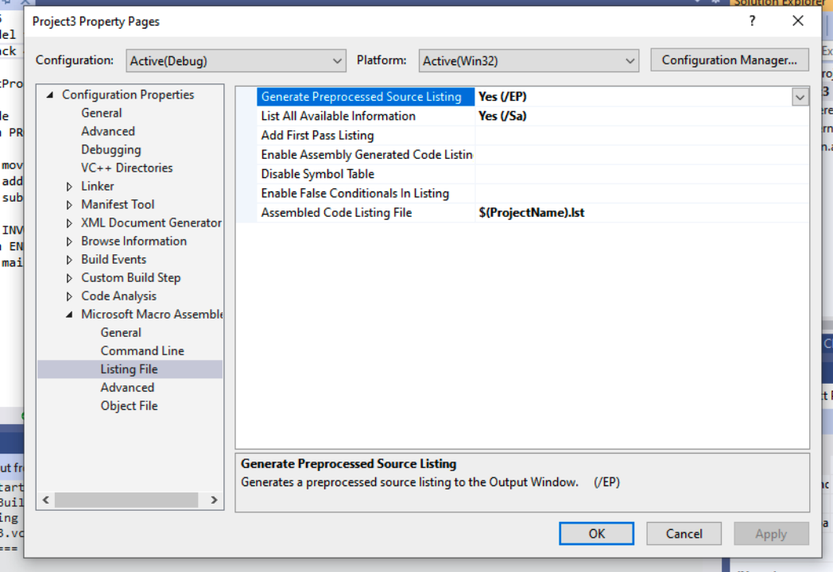
Error Fix: 2. Re-enter listing file configuration
Select Properties from the Project menu.
Under Configuration Properties, select Microsoft Macro Assembler.
In the dialog window,
set Generate Preprocessed Source Listing to Yes,
set List All Available Information to Yes.
Write $(ProjectName).lst in
Assembled Code Listing File

Slide 31
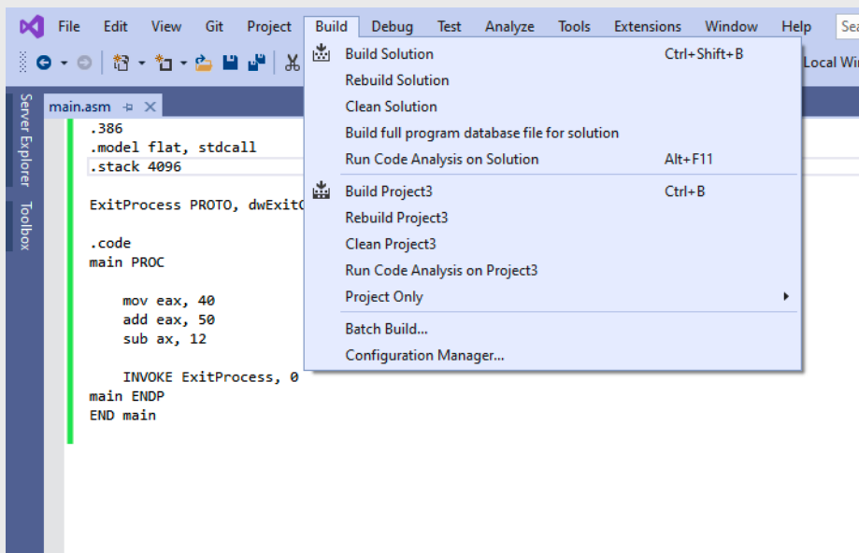




Error Fix: 2. Clean and Build the Project again
Go to Build menu
Click Clean Project
Go to Build menu again
Click Build Project

Slide 32
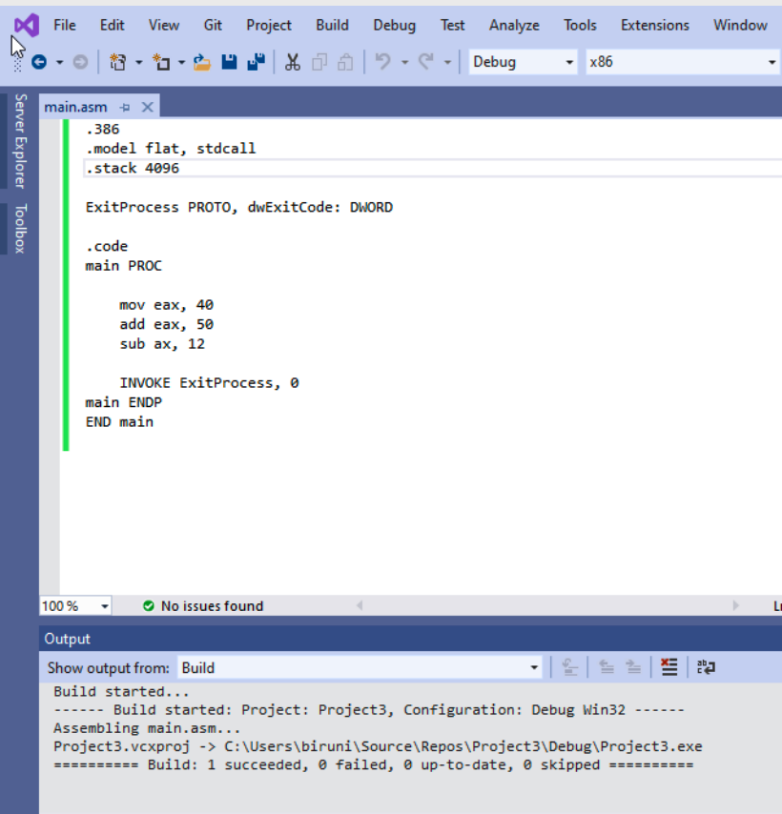



The error should go away

Slide 33
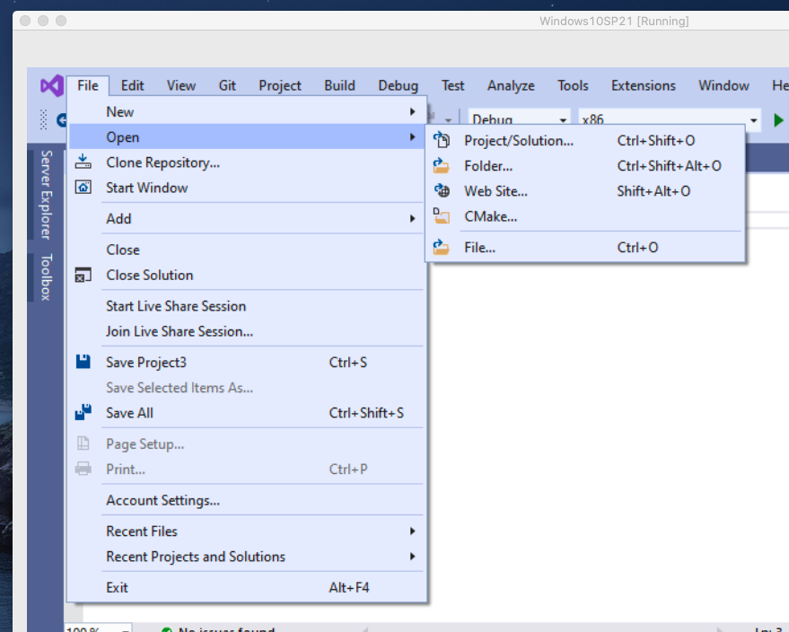
Step 4: Open listing file
Go to the File Tab
Click open
Then choose file

Slide 34
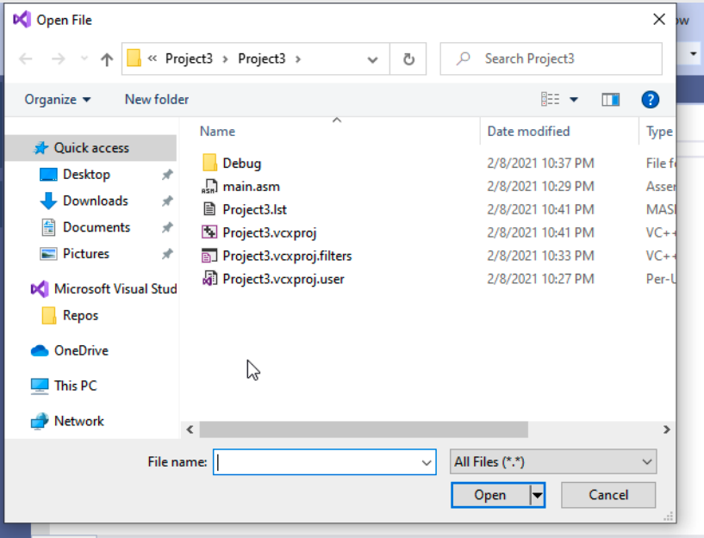

Step 4: Open listing file
The listing file is created with .lst extension
Select .lst file
The listing file have the same name as the project name.

Slide 35
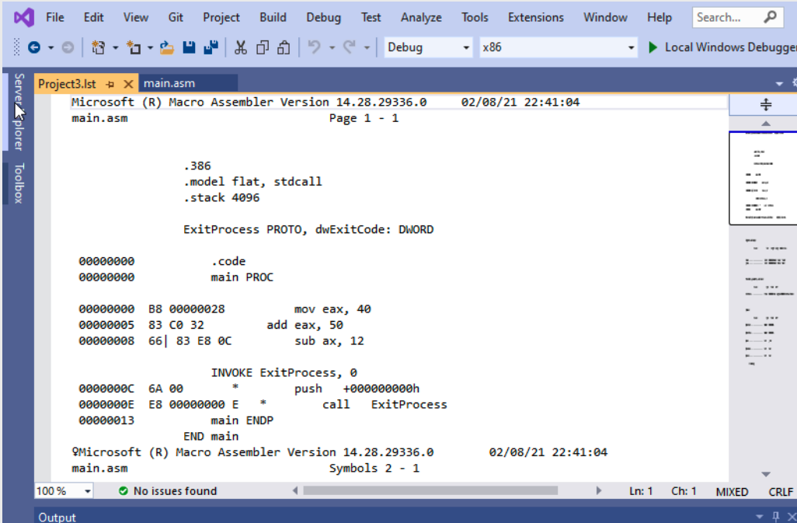
Step 4: Open listing file

Slide 36
Lab 5
Submission Instruction

Slide 37
Problem 1
Assume that you have 8-bit registers.
Write and run a program with following instructions:
mov 20 to AL register
mov 100 to AX register
mov 1000 to EAX register
add 2 to the content of EAX register
subtract 20 from al register
Generate listing file for the program

Slide 38
Submission Instruction
Generate the listing file.
Take a screenshot of the listing file content
Submit the screenshot at iCollege.

